Slide 1
Switching & LAN Design

Slide 2


Layer 2 devices
A layer 2 device is a device that understand MAC,
for example:
  NIC (Network Interface Card)
  Bridge :
  - address learning
  - forwarding decisions are based on software
  - bridge is used for LAN segmentation
  - max. 16 port.
  Switch:
  - a multi-port bridge up to 256 port
  - forwarding decisions are based on hardware ASIC
  (faster than bridge)

Slide 3
What is the meaning of switching?
Switching means that the device (router or switch) receive the data on a certain port and forwards it to appropriate port

Slide 4
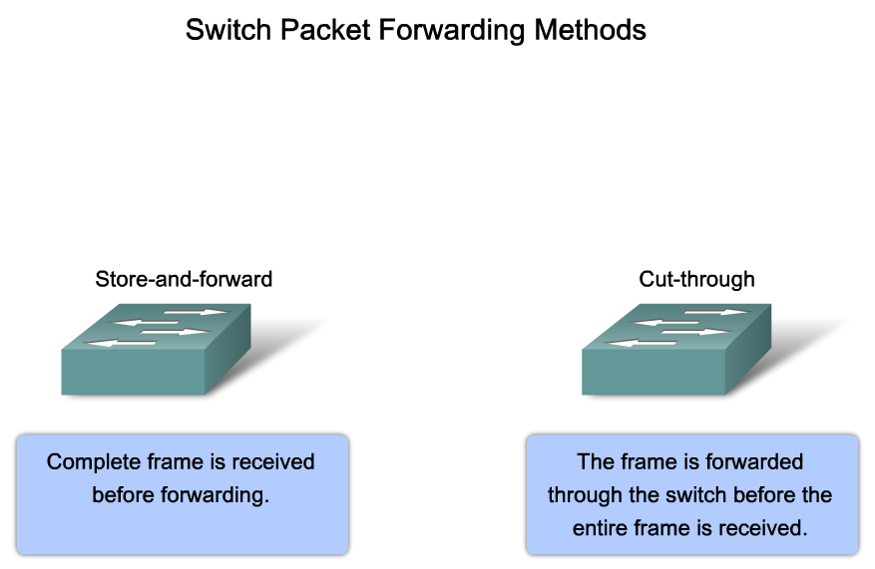
Explain the Functions that Enable a Switch to Forward Ethernet Frames in a LAN
Notes:
Graphic 2.2.1.1

Slide 5
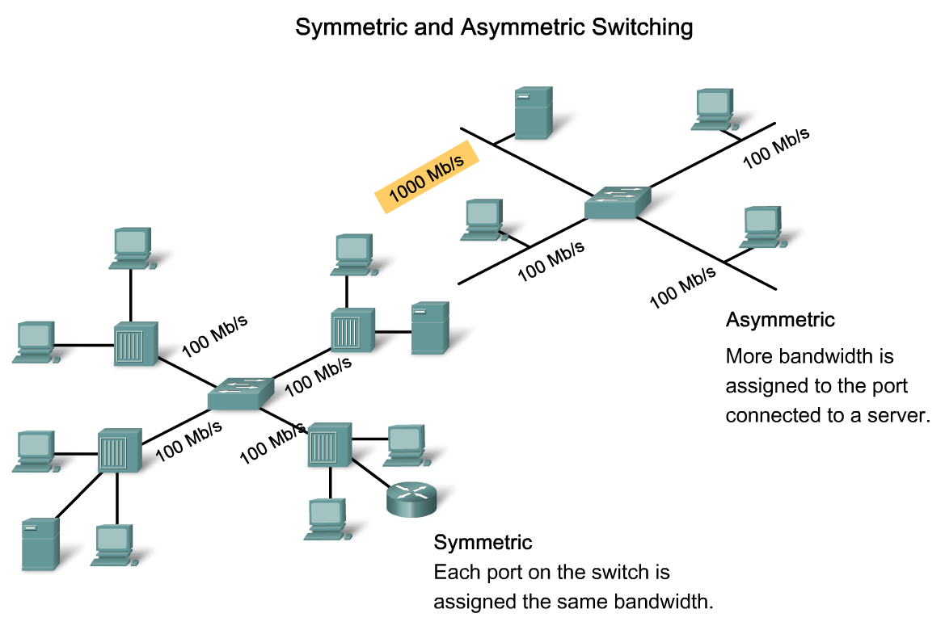
Explain the Functions that Enable a Switch to Forward Ethernet Frames in a LAN
Notes:
Graphic 2.2.2.1

Slide 6
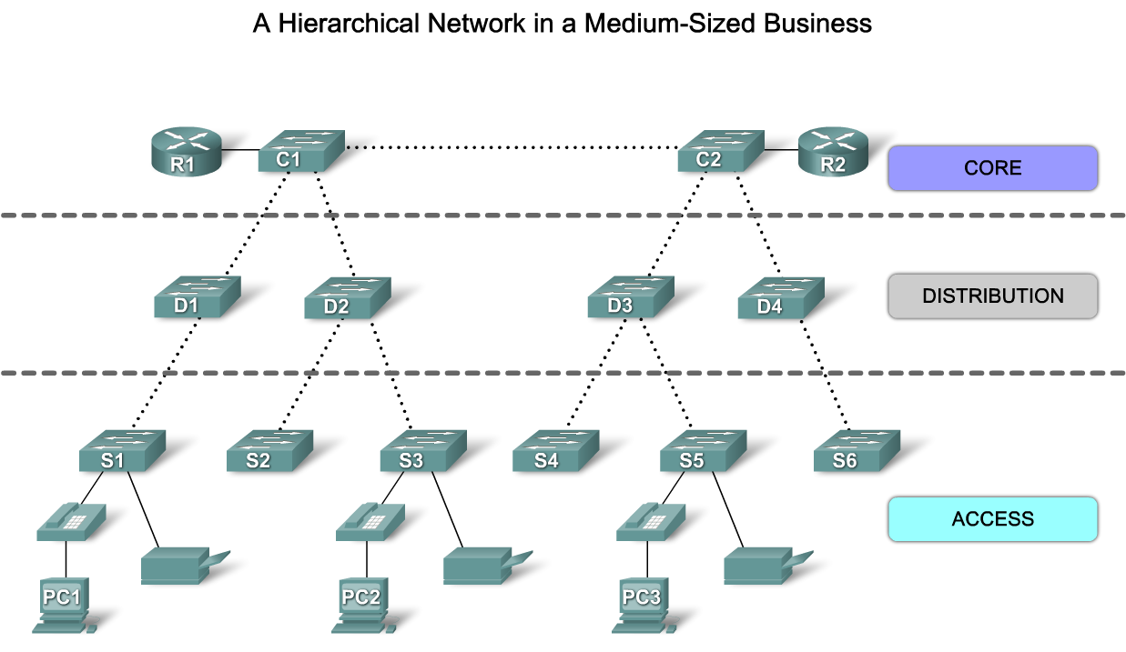
Hierarchical Network Design
Notes:
Use graphic 1.1.1.2

Slide 7
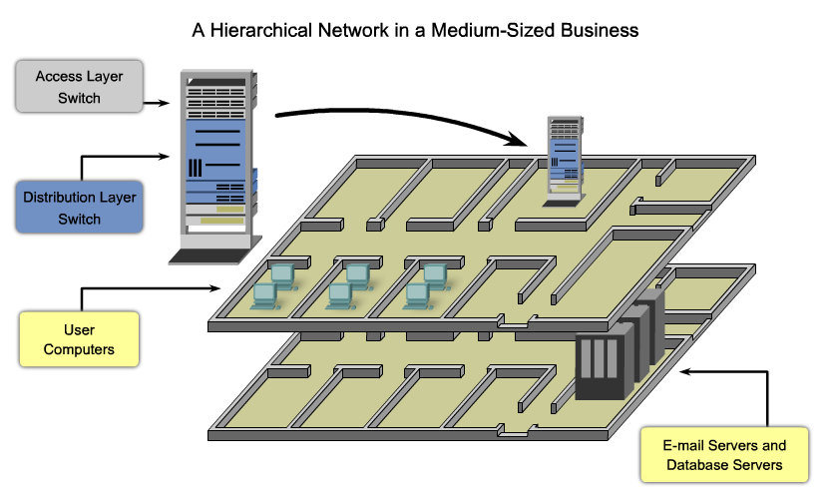
Hierarchical Network Physical Layout

Slide 8
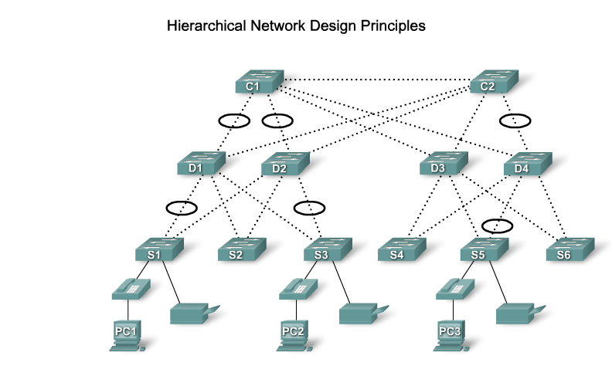
Hierarchical Network Design

Slide 9
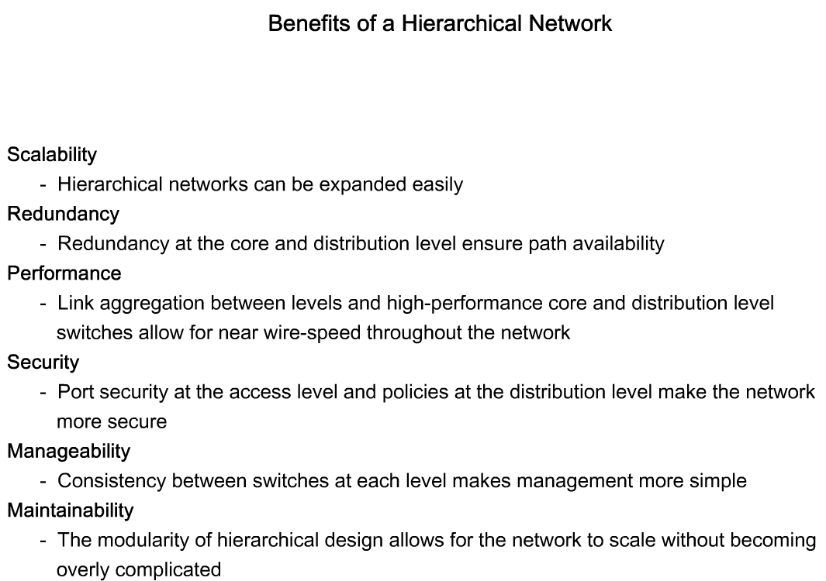
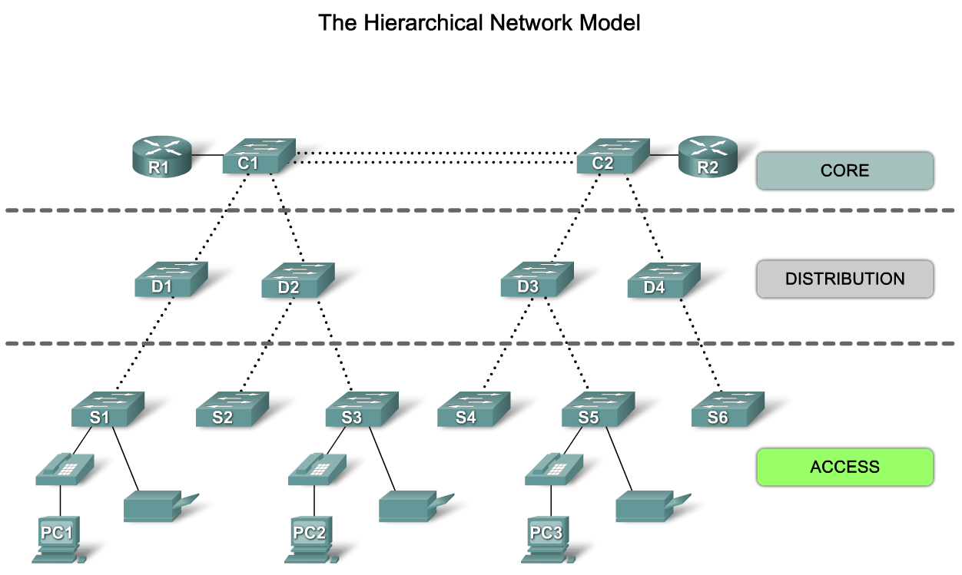
Hierarchical Network Design
Notes:
Use graphic 1.1.1.1
Use graphic 1.1.1.3

Slide 10
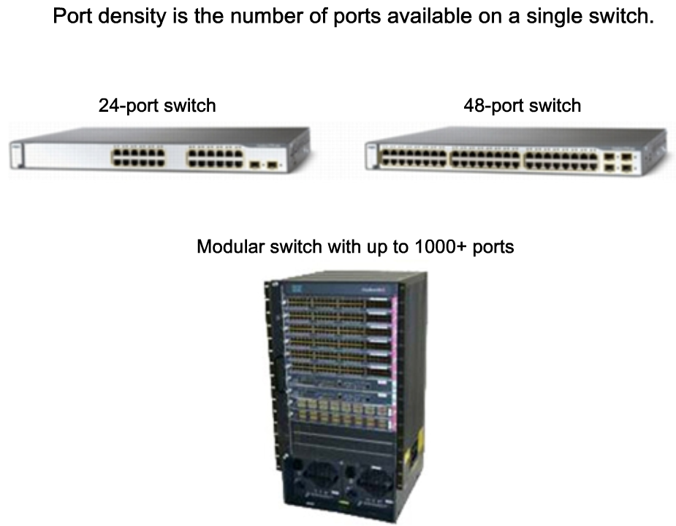
Match the Appropriate Cisco Switch to each Layer in the Hierarchical Network Design Model
Notes:
Graphics from section 1.2.2 pages 2 & 3

Slide 11
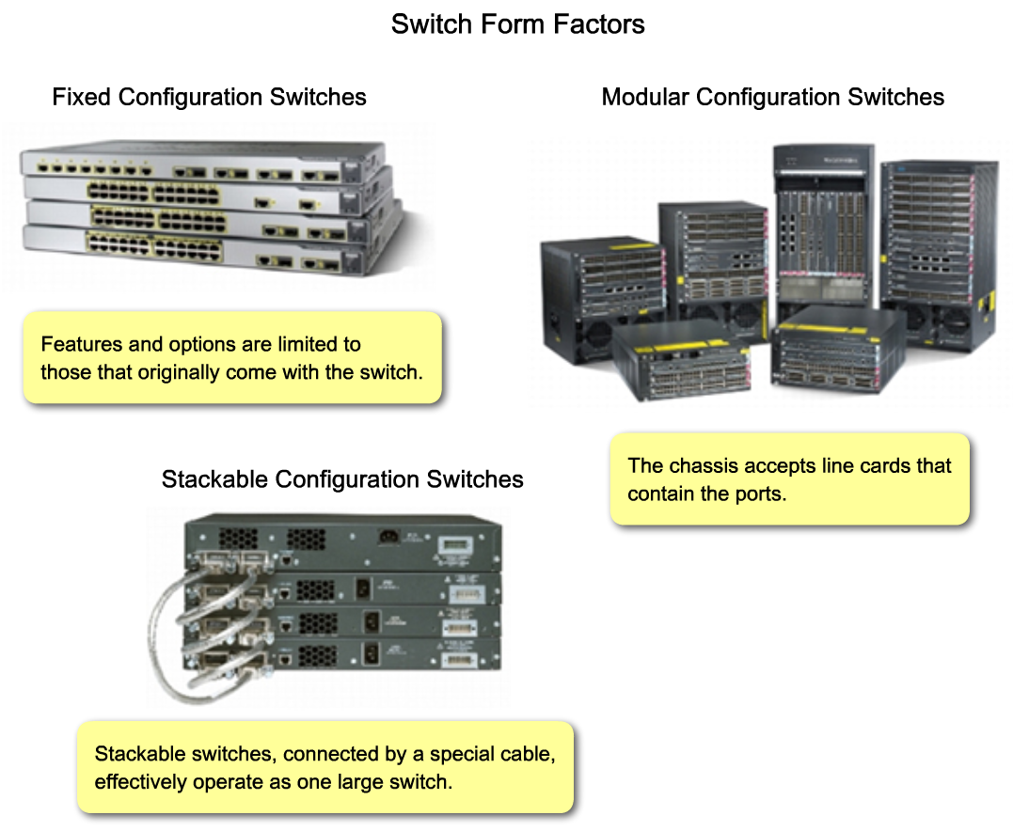
Match the Appropriate Cisco Switch to each Layer in the Hierarchical Network Design Model
Notes:
Graphics found in section 1.2.1 & 1.2.2

Slide 12
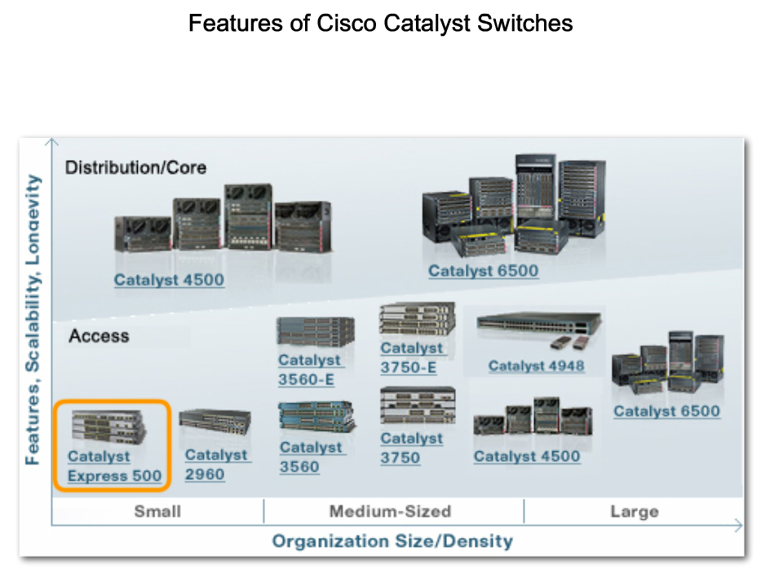
Match the Appropriate Cisco Switch to each Layer in the Hierarchical Network Design Model
Notes:
Use graphic 1.2.4.1

Slide 13
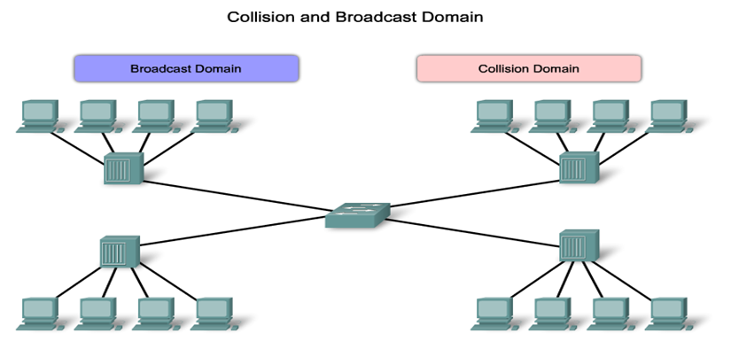

Uncontrolled collision & broadcast domains

Slide 14
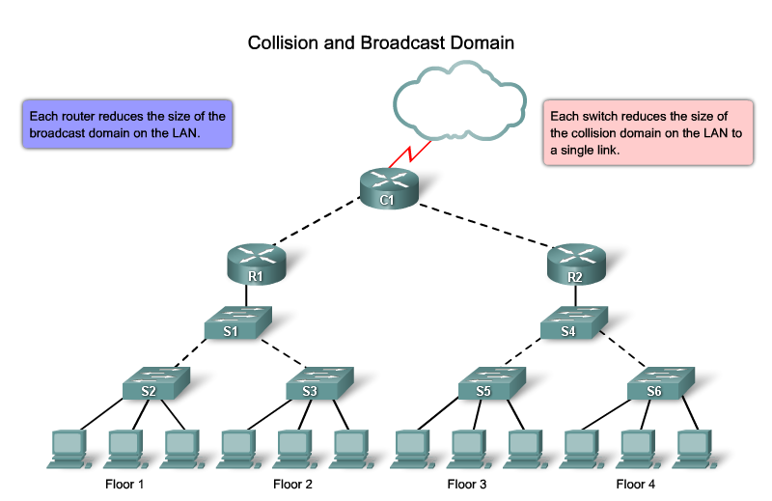
Controlled collision & broadcast domains

Slide 15
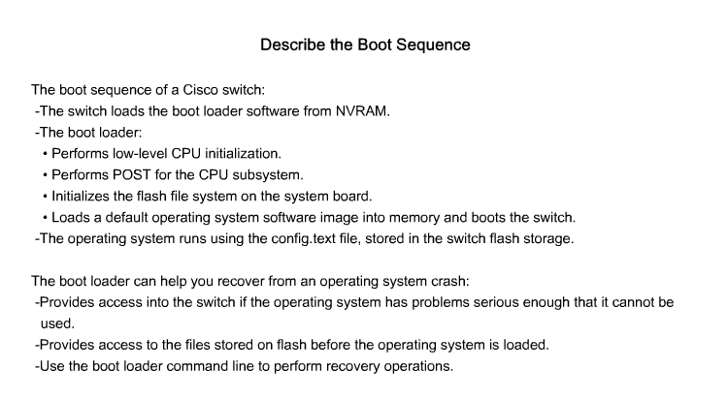
Switch boot sequence

Slide 16
Switch boot sequence
The switch uses the flash memory to store two types of files :
    The IOS of the switch
    The VLAN database
The switch uses the NVRAM to store two types of files:
    The boot loader
    The configuration file

Slide 17
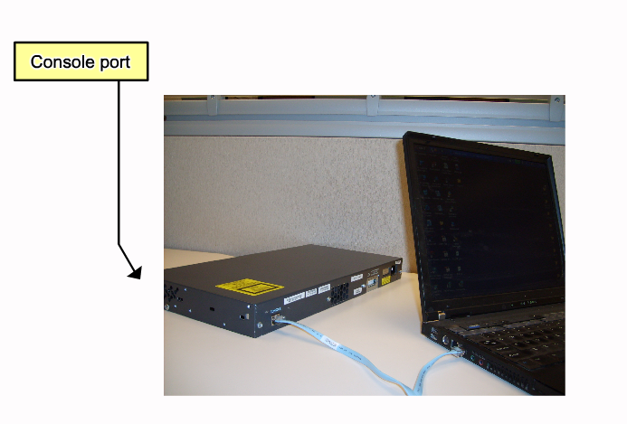
The CLI of the switch
the CLI of the switch is like the CLI of the router

Slide 18
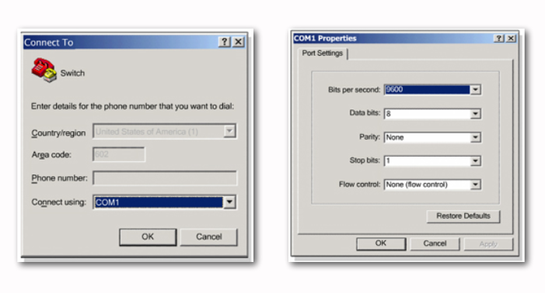
The CLI of the switch

Slide 19
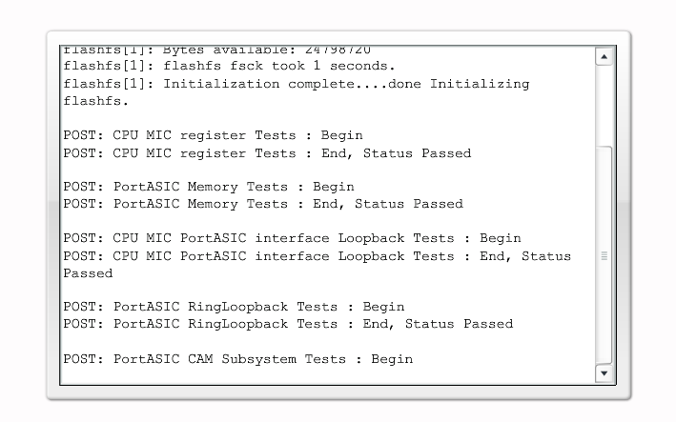
The CLI of the switch

Slide 20
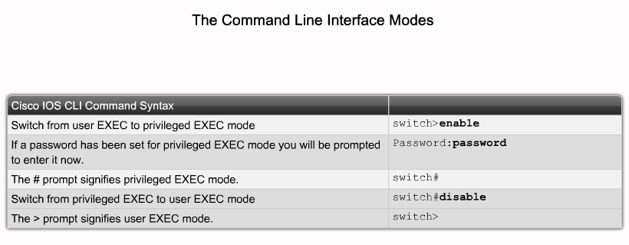
The CLI of the switch

Slide 21
The CLI of the switch
To configure the basic configuration of the switch, like the router basic configuration:
  Set the hostname
  Set the message of the day
  Set enable password in (clear text or encrypted text)
  Set the interfaces configuration (speed and duplex type)

Slide 22
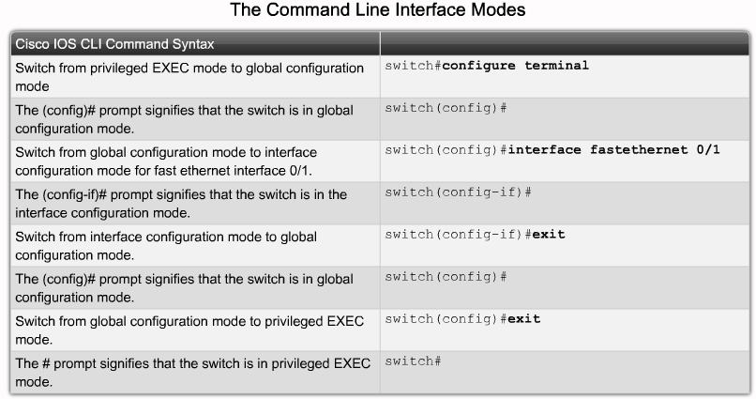
The CLI of the switch

Slide 23
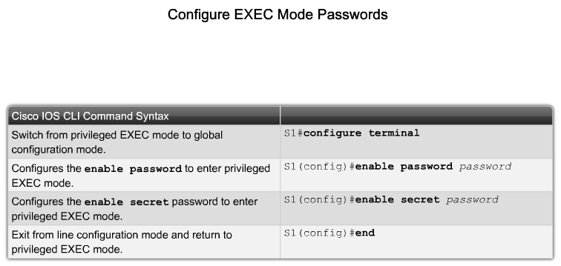
The CLI of the switch

Slide 24
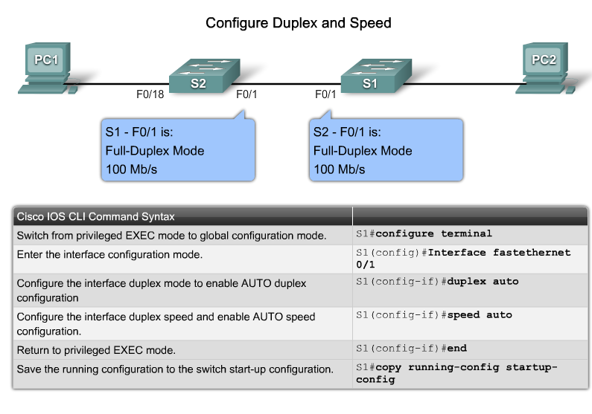
The CLI of the switch

Slide 25
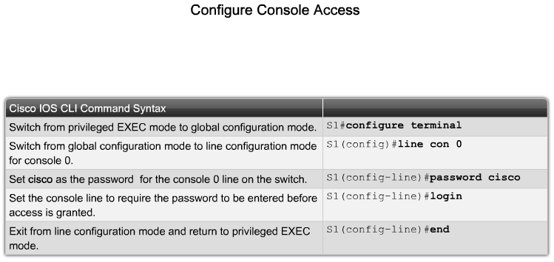
The CLI of the switch
Set console password

Slide 26
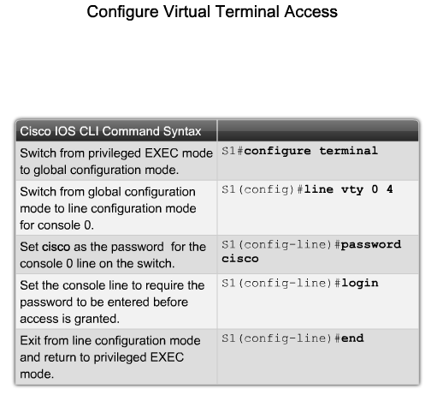
The CLI of the switch
Set the telnet password

Slide 27
The CLI of the switch
To be able to telnet to or from the switch you should set an IP address and the default gateway on the switch as it is a normal PC
To do so:
  Switch(config)# interface vlan1
  Switch(config-vlan)# ip address 10.10.10.10 255.255.255.0
  Switch(config-vlan)# no shutdown
  Switch(config-vlan)# exit
  Switch(config)# ip default-gateway 10.10.10.1

Slide 28
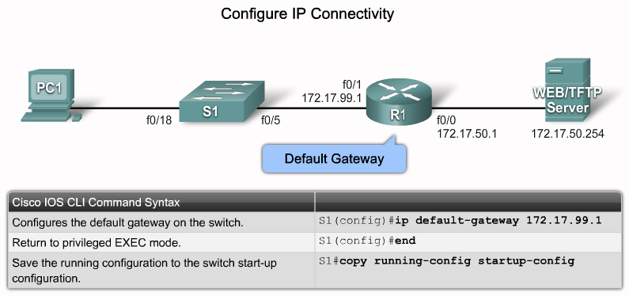
The CLI of the switch

